Slide 1
Drive user engagement across all your devices with Microsoft Graph
Justin Liu
Senior Program Manager
Notes:
Hello everyone! Welcome back. My name is Justin Liu, I am from Microsoft. Today apart from being a banana, I am also here to talk to you about driving user engagement across all your devices with Microsoft Graph.
So these days we are often in situations where we work on something on one device and later on we want to continue working on the same thing on another device. We have apps that run across these devices and MS Graph is able to help us tie those activities together.

Slide 2
Microsoft Graph
What is it and why is it important to you?
Getting started and tools
API highlights
Cross-device and Timeline
Notes:
So there’s a lot we can talk about, but today I’d like to focus on just a few key things.
First of all, we are gonna talk about why the Graph is important? We touched a little bit on what it is, we will go a little bit deeper.
And we are going to show you some tools that would help you get started,
After that, we will see a demo and highlight some key APIs,
Finally, we are gonna end with cross-device scenarios and Windows Timeline integration.

Slide 3
Microsoft Graph
What is it and why is it important to you?
Getting started and tools
API highlights
Cross-device and Timeline

Slide 4

Microsoft Graph is all about you
If you or your customers are part of the millions of users that are using Microsoft cloud services, then Microsoft Graph is the fabric of all your data
/me/messages
/me/photo
/me/insights/trending
Notes:
The technical term of MS Graph is, it’s a unified rest API for accessing all your data in the MS Cloud. The key words there are “your data”, it’s all about you.
If you remember a little bit earlier in the keynote, the graph explorer, every single rest api starts with “/me”.
/me/messages all my mails
/me/photo my photo
/me/insights/trending items trending around me, things I am interested in.
But you might ask, How do I get my data into the Graph so I can start consuming them?
The answer is, you don’t need to “add” your data into the Graph. As long as you are using MSFT services, this data is already available for you through the MS Graph.

Slide 5
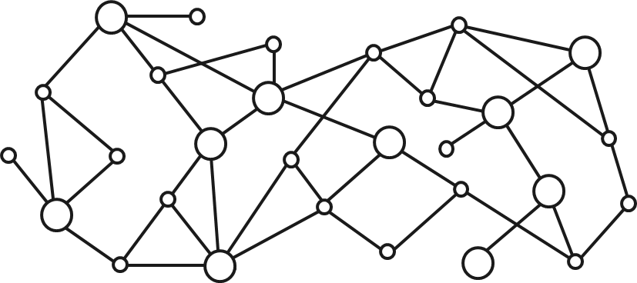
Gateway to your data in the Microsoft cloud
Your app
Web Apps
Device & Native
Apps
Bots
Background
processes
1
Gateway
Microsoft Graph
Office 365
Windows 10
Enterprise Mobility + Security
You or your customer’s data
Microsoft identity
Rich content
Deep insights
Real-time updates
Notes:
Conversational data from MS Teams
Files and documents from SharePoint or OneDrive
Emails and meeting information from Outlook
So the Graph here is basically a single Gateway for you to connect your app with various Microsoft services.
This means it doesn’t matter what type of user you are, you can be an Office 365 user, a Windows 10 MSA user, or even an EMS customer.
You will only need to deal with ONE authentication key and to work with one set of APIs.
And it gives you more than your original data, it insights to it. You can get real-time updates as well, by using delta query and webhooks.

Slide 6
Opportunity
90%
135M
450B
Fortune 500 companies have data in Microsoft Graph
Monthly active users in Office 365
Users authenticated each month
65M+
181
1B+
Enterprise Mobility seat install base (+55% YoY)
Countries with knowledge workers using Office 365
Meetings scheduled each month with Office 365
Notes:
All of this brings us great opportunities.
Have a look at the slide here, they are super impressive.
Imagine what you could do with all these customers in the Graph?
For me personally, I am quite interested in the last one – over 1B meetings scheduled every month!
I wonder what I can do with my meetings as I do get a lot of them. Let’s see about that in a second.

Slide 7
Microsoft Graph
What is it and why is it important for you?
Getting started and tools
API highlights
Cross-device and Timeline
Notes:
OK, so that was a just quick overview on what the Graph is, and now let’s have a look some tools.

Slide 8
Developing with Microsoft Graph
graph.microsoft.com
TRY
LEARN
DEVELOP
Graph Explorer and quick starts
With docs and API reference
With SDKs, samples, and tooling
Notes:
We showed you a little bit about the graph tool this morning.
Graph.Microsoft.com is a great place for you to get started.
Make sure you try the API before writing any code, specifically the Graph Explorer and various samples on the website.

Slide 9
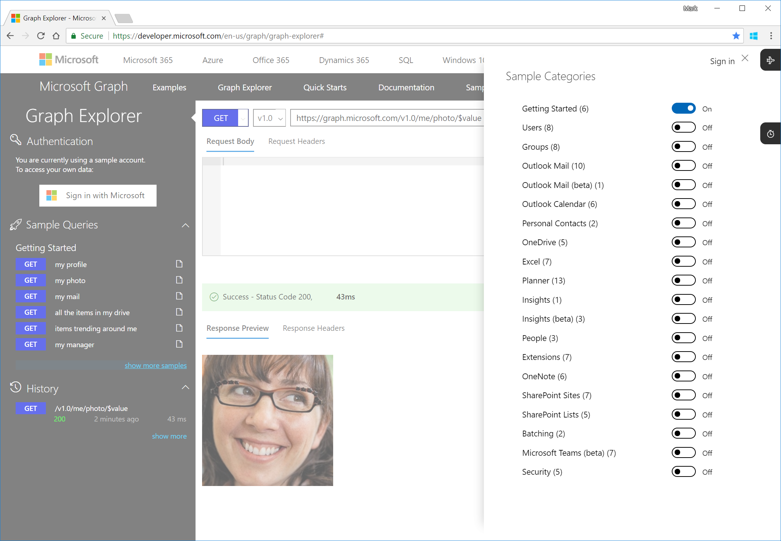
TIP: Graph Explorer is your best friend
Quickly try requests
from your browser
Supported accounts:
Demo (commercial)
Consumer (@outlook.com)
Commercial (@fabrikam.com)
And it’s open source
Caution: if you sign in, Graph Explorer can actually create/modify data
Notes:
So one thing to be cautious with the Graph Explorer is, by default, it’s using a demo account, so you don’t have to login, but if you do, you can either login with your personal account or work account. And remember, if you do that, you can potentially modify your real data!
Say if you change your name to something else just to test the API, don’t forget to change it back! OK? So just be careful.
Graph Explorer is a customized HTTP request tool that makes it really easy to discover and execute queries.
Along the left nav is a series of categorized requests, and you can click on “show more samples” to add or remove categories.
In the main window, you compose your request and view the response. When you type in the URL bar, Graph Explorer will suggest some query options for you to choose, but really you can issue any query against Graph, even if the autocompletion doesn’t suggest it.
Note that if you haven’t explicitly logged in, Graph Explorer is logged in with a demo account and will not allow data modification.
Fortunately, Graph Explorer supports logging in with a work or personal account, at which point you can modify data – but remember, this is the real deal! Whatever you do through the API is actually happening.

Slide 10
Demo
Graph Explorer

Slide 11
Microsoft Graph
What is it and why is it important for you?
Getting started and tools
API highlights
Cross-device and Timeline

Slide 12
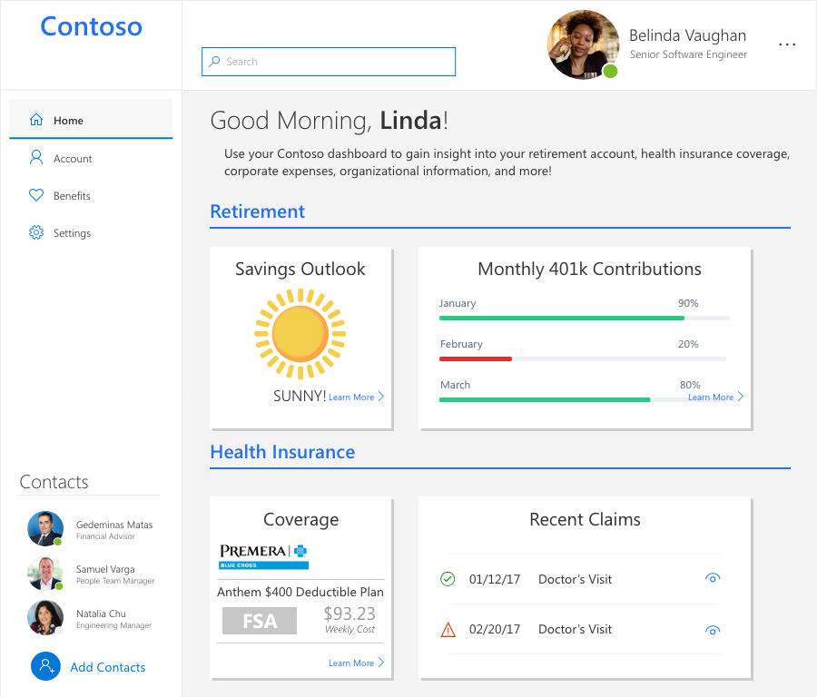
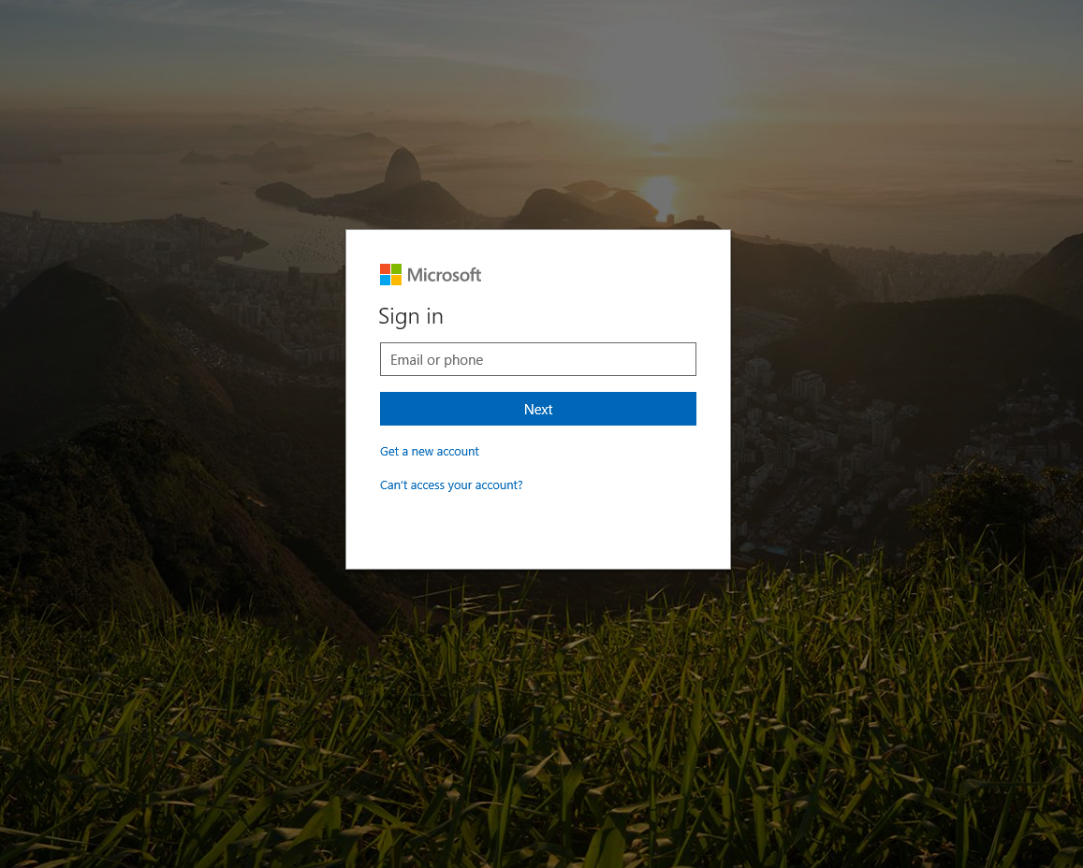

Leverage Microsoft identity
/me/photo/$value
Yina Arenas
Principal PM
New login from this device
/security/alerts
Yina!
/me
/me/people
Notes:
So next I am going to show you a couple of screenshots of a web application that uses the Graph API.
First, you would see a very standard MSFT login page. Note that you don’t need to code this page, as long as you are using the Graph authentication, you get the UI automatically.
And once we logged in, this is the main page, you can kind of tell where the data comes from –
And look how easy it is to add some useful information to your app, with only a few rest APIs.

Slide 13
Document Approval workflow
SELECT DOCUMENT
BUILD EMAIL
SEND EMAIL
Get documents on OneDrive
Get user photo
Send email
GET /drives/{id}/root/children
POST /me/photo/$value
POST /me/sendMail
Select file
Get thumbnail
GET /drives/{id}/items/{id} /thumbnail
GET /drives/{id}/items/{id}
Get thumbnail
Get sharing link
GET /drives/{id}/items/{id} /thumbnail
POST /me/drive/items/{itemId}/createLink
Notes:
And here’s another example, say I want to use the Graph API to send an email to someone about some document approval:
Get the documents and select a file and thumbnail
Build a message from the user (name email) include the thumbnail and share link of the document
Send the message!
Looks easy right? But can we do better here?
Still need to manually login, get photos, documents…
And the good news is, we just announced a new version of Windows Community Toolkit, previously known as the UWP Community Toolkit, which contains a new set of Graph controls.

Slide 14
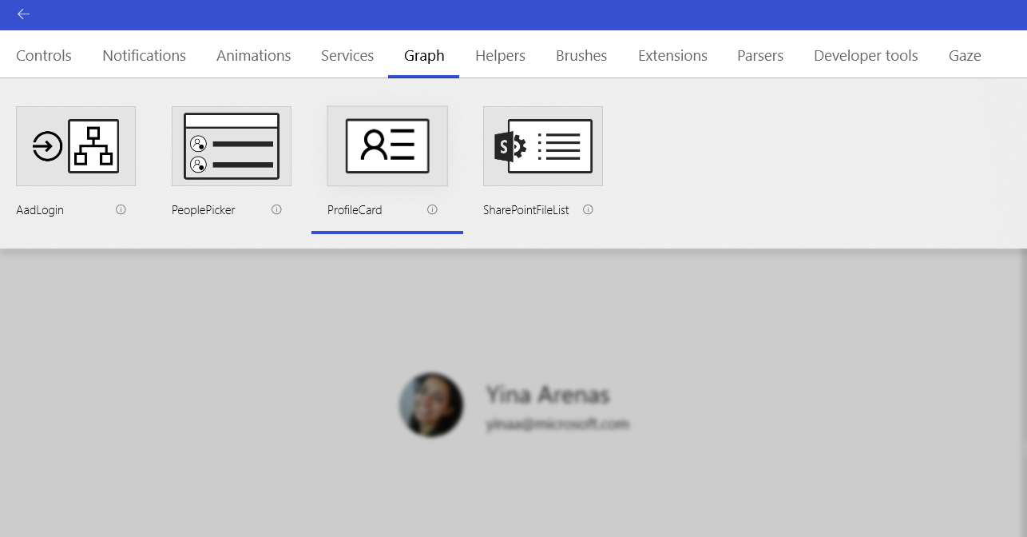
New UWP controls for Microsoft Graph
https://aka.ms/windowsToolkit
Notes:
All you need is to provide a client ID for the authentication.
Killian actually already showed you how to get a client id in her session…

Slide 15
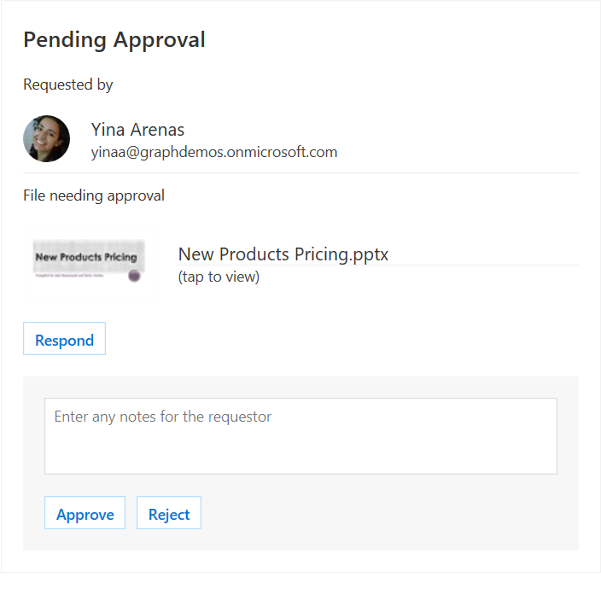
Adaptive cards
JSON based schema
Easy to author
Render in:
Bot Framework
Cortana
Outlook
Microsoft Teams
Skype
Windows timeline
Windows notifications
Notes:
Since we talked about UI, let’s go a little bit deeper on it.
As you already know, MS Graph is all about the data. But how can we provide a better user experience with the data we have?
For example, if I talk to a bot, in a Skype chat, I don’t really feel like reading too much conversation. I just want dropdowns for me to select, and buttons for me to confirm, and they should be grouped inside a card so it’s super clear.
Or another example, when I am on Outlook, and I received a document approval email, like the one I just showed you earlier. Most of the time, I just want to see an overview of the document followed with an approval button for me to click to approve it, right inside my email.
And all of these scenarios are the reasons that why we created Adaptive Cards. They are card-like UI that helps us create great user experience in a simple and consistent way.
They are smart, because they have the data from the Graph;
They are interactive, ‘cause they support controls like buttons or dropdowns.
And most importantly, they are platform independent and across devices, because they are just json schemas.
Currently in Windows, we already have adaptive cards running inside a lot of apps, for example… as you have already seen in Killian’s bots, there’s an adaptive card.

Slide 16
Demo
Adaptive cards
Notes:
Let me show you a website where you can learn all about the adaptive cards.
One important feature of the adaptive cards that I didn’t mention is that the UI would adapt based on what app it is in.

Slide 17
Microsoft Graph
What is it and why is it important for you?
Getting started and tools
API highlights
Cross-device and Timeline

Slide 18
Microsoft graph Activity & Device APIs
Activities
Get you app activities in the Windows Timeline
Let customers pick up where they left off
Feed is synchronized effortlessly across devices & platforms
Activities API
List, create, replace, delete activities
Devices
Discover and connect to user's devices
Remotely launch apps on those devices
Send messages to your apps on those devices
Device API
List devices
Send commands
Get command status
Notes:
In cross device scenarios, MS Graph has two APIs that help with it, they are Activity APIs and Device APIs.
Activity API basically can create an activity of what you are currently doing, save it to the Graph,
and Device API can discover all your registered devices, and as soon as you start using the same app on another device, the Graph will push that activity to your device so you will be right at where you left off.

Slide 19
Microsoft graph activities APIs
Request
PUT https://graph.microsoft.com/v1.0/me/activities/uniqueAppIdInContext HTTP/1.1
{ "appActivityId": "uniqueIdInAppContext",
"activitySourceHost": "https://myappsuniquedomain.com",
"appDisplayName": "Graph Demo",
"activationUrl": "https://developer.microsoft.com/en-us/graph/graph-explorer",
"visualElements": {"displayText": "Microsoft Graph Sample User Activity"},
"historyItems": [
{
"userTimezone": "America/Los Angeles",
"startedDateTime": "2018-04-22T20:40:04.345Z",
"lastActiveDateTime": "2018-04-23T21:00:24.345Z"
}
]
}
Notes:
And this is how a simple activity api would look like. It’s basically a json object.
A deep link to your app so the user can resume the activity.
Let’s take a look at how an activity would look like, visually, by going through another demo.

Slide 20
Demo
Activities in the Windows timeline
Notes:
Alright, here comes our last demo, and we are gonna show you how to create an activity for a UWP app in Windows Timeline.

Slide 21
aka.ms/insiderdevtour-labs
Build a graph app from starter kits
Manage files and content with Graph API
Write user activities with adaptive cards

Slide 22
Intelligence at the Edge – getting started with machine learning
Speaker Name

